Slide 1



Heart Attack Risk Prediction Using Ordered Logistic Regression Using R
Masood Ahmed
Roll no: 24

Slide 2

Introduction
Ordinal Logistic Regression is a statistical method used to predict the relationship between one or more independent variables (predictors) and a dependent variable that has ordered categories.
1
Ordered Logistic Regression
2
Project Objective
Used to predict ordinal variables.
Predict heart attack risk levels.

Slide 3
Dataset Overview
Variable
Description
Age
Age of the individual.
Sex
0 (Female), 1 (Male).
Chest Pain Type
0: Typical Angina, 1: Atypical Angina, 2: Non-anginal Pain, 3: Asymptomatic.
Resting Blood Pressure
Blood pressure at rest (mm Hg).
Cholesterol
Serum cholesterol level (mg/dL).
Fasting Blood Sugar
0 (<=120 mg/dL), 1 (>120 mg/dL).
Resting ECG
0: Normal, 1: Abnormal, 2: Hypertrophy.
Max Heart Rate
Maximum heart rate achieved during exercise.
Exercise-Induced Angina
0 (No), 1 (Yes).
Oldpeak (ST Depression)
Depression in ECG during exercise (mm).
Slope of ST Segment
0: Upsloping, 1: Flat, 2: Downsloping.
Num Vessels Fluoroscopy
Number of major vessels (0 to 3).
Thalassemia
0: Normal, 1: Fixed Defect, 2: Reversible Defect.
Risk Level
0 (Low), 1 (Medium), 2 (High) – Target variable for heart attack risk.

Slide 4
Exploratory Data Analysis (EDA)
Understanding and exploring our data.
Number of Rows | 100
Number of Columns | 14
Dimension of dataset | 100, 14
To check if there is any missing values in our | datasetsum(is.na(heart_data))
Libraries that I have used
Tidyverse
ggplot2
Caret Mass
Key observations:
The majority of patients (180) fall within the 51-65 age group
Middle-aged groups (36-50 and 51-65) represent the highest concentration of cases
Younger (20-35) and elderly (65+) groups show comparatively lower frequencies
This distribution suggests that heart attack risk monitoring should be particularly emphasized for middle-aged individuals

Slide 5
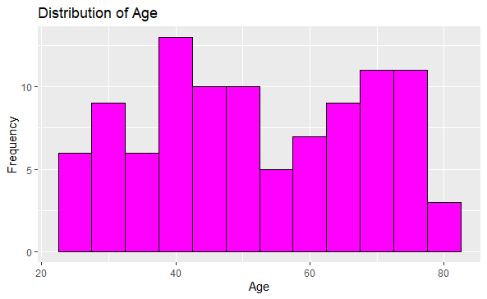
Age Distribution Analysis
Understanding the age patterns in our heart attack risk dataset.
Key observations:
The majority of patients (180) fall within the 51-65 age group
Middle-aged groups (36-50 and 51-65) represent the highest concentration of cases
Younger (20-35) and elderly (65+) groups show comparatively lower frequencies
This distribution suggests that heart attack risk monitoring should be particularly emphasized for middle-aged individuals

Slide 6
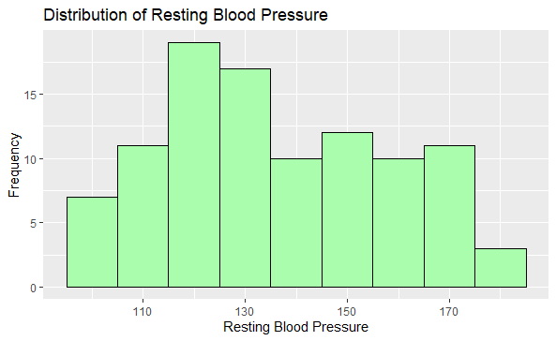
Distribution of Resting Blood Pressure
The histogram shows the distribution of resting blood pressure measurements across the patient population. The data reveals a roughly normal distribution with most readings falling between 120-140 mmHg. This aligns with typical adult blood pressure ranges, though there are notable cases in both higher and lower ranges that warrant careful clinical consideration.

Slide 7
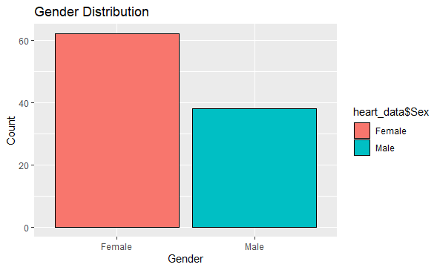
Gender Distribution in Dataset
The dataset shows a higher representation of male patients (207) compared to female patients (96), which should be considered when interpreting the model results.

Slide 8
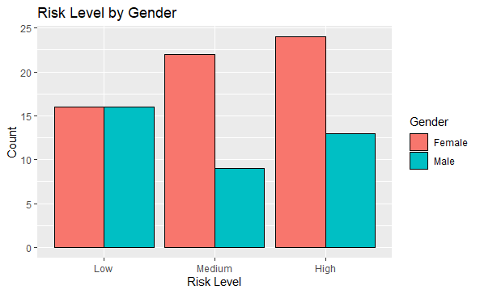
Heart Attack Risk Level Distribution by Gender
Low Risk
Medium Risk
High Risk
The chart illustrates the distribution of heart attack risk levels across gender groups, with males showing higher absolute numbers across all risk categories due to their larger representation in the dataset (207 males vs. 96 females). This visualization maintains the proportional relationships while highlighting the need to consider gender differences in risk assessment.

Slide 9
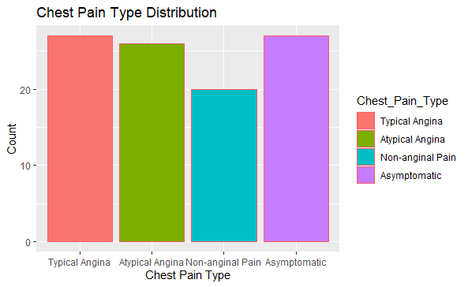
Distribution of Chest Pain Types
The chart shows the distribution of chest pain types across the patient population. Typical angina is the most common presentation, followed by atypical angina. The presence of asymptomatic cases highlights the importance of regular cardiac screening even in the absence of chest pain.

Slide 10
Model Building
Variables Used
Model Implementation
Our ordered logistic regression model incorporates 13 key clinical indicators, including vital signs, medical history, and test results. Each variable was carefully selected based on its clinical relevance to heart attack risk assessment.
olr_model <- polr(
Risk_Level ~ Age + Sex +
Chest_Pain_Type + Resting_BP +
Cholesterol + Fasting_Blood_Sugar +
Resting_ECG + Max_Heart_Rate +
Exercise_Induced_Angina +
Oldpeak + Slope +
Num_Vessels_Fluoroscopy +
Thalassemia,
data = train_data,
Hess = TRUE)
Patient demographics (Age, Sex)
Cardiac indicators (Chest Pain, ECG results)
Vital measurements (Blood Pressure, Heart Rate)
Clinical tests (Cholesterol, Blood Sugar)

Slide 11
Coefficient's understanding
Odds Ratio (OR) tells us how the odds of being in a higher risk category change with each one-unit increase in a predictor.
If OR > 1, it means the factor increases the chances of being in a higher risk category.
If OR < 1, it means the factor decreases the chances of being in a higher risk category.
If OR = 1, it means the factor has no effect on the odds of being in a higher risk category.

Slide 12
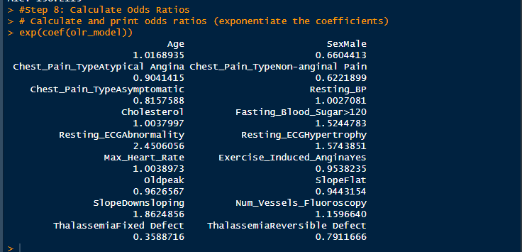
Model Coefficient

Slide 13
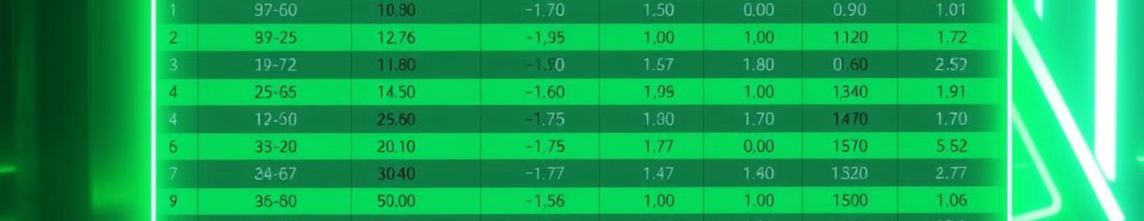
Results
Some factors Increase the odds of being at higher risk (like abnormal ECG, High fasting blood sugar, and a downs loping slope).
Others factors Increase the odds of being at higher risk ( Like being male, having non aginal pain and having fixed Thalesemia defect)
And many predictors variable does not show statistically significant effect (Like Age, Sex, Chest pain type)

Slide 14
Thank You

